Slide 1


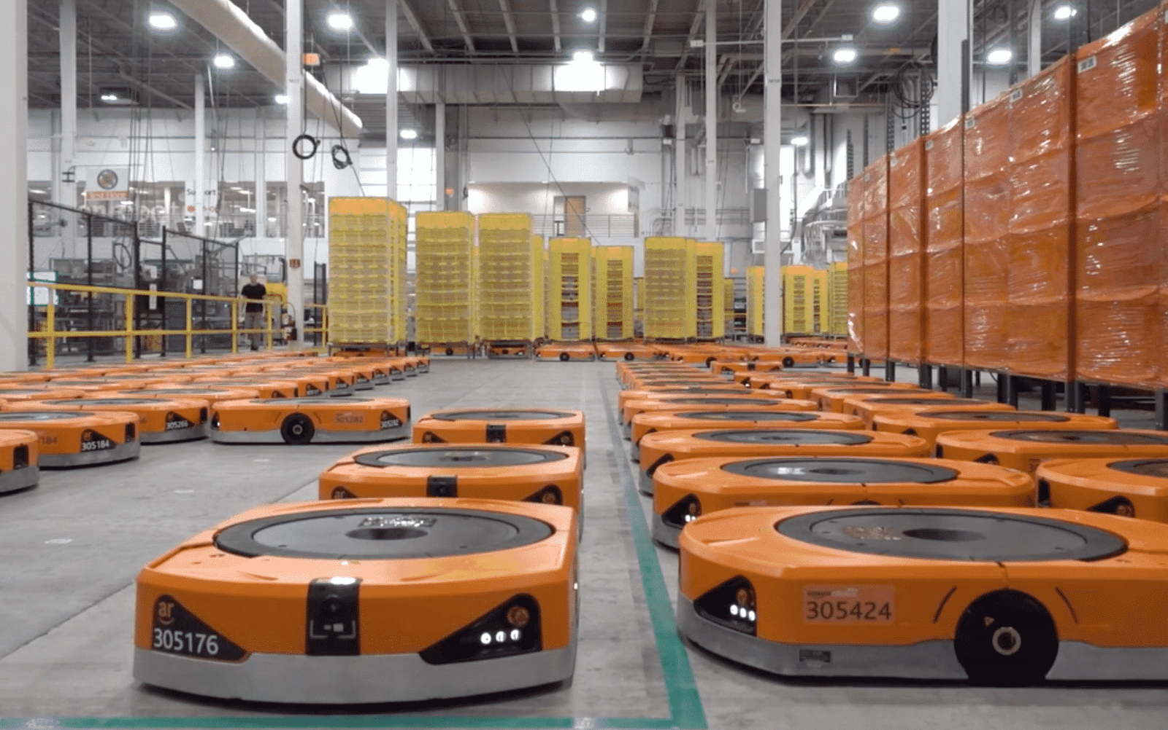
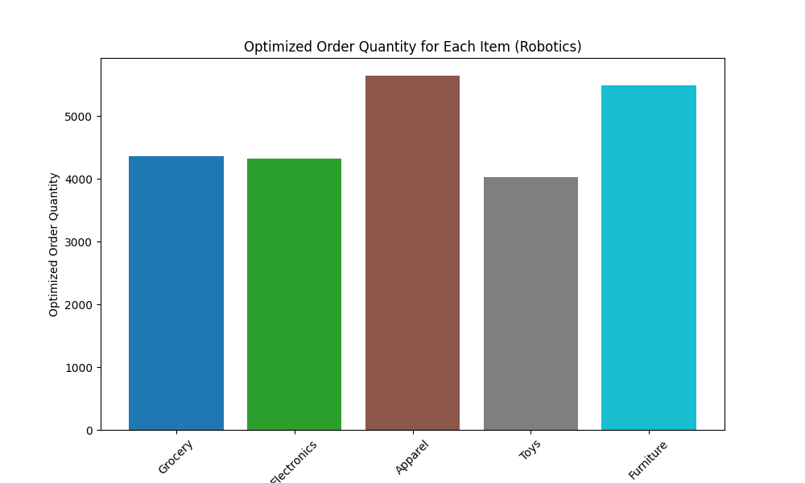
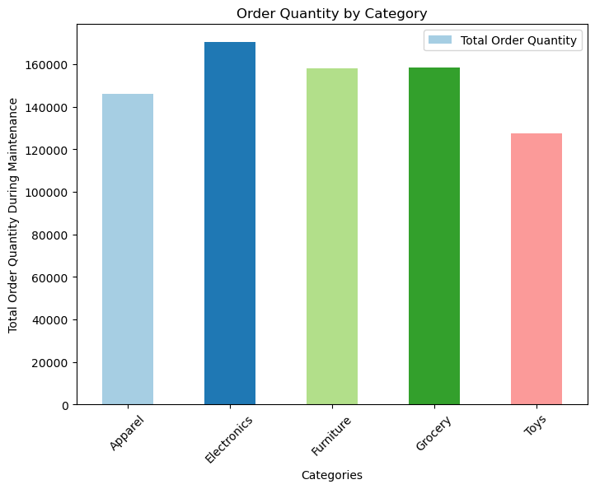
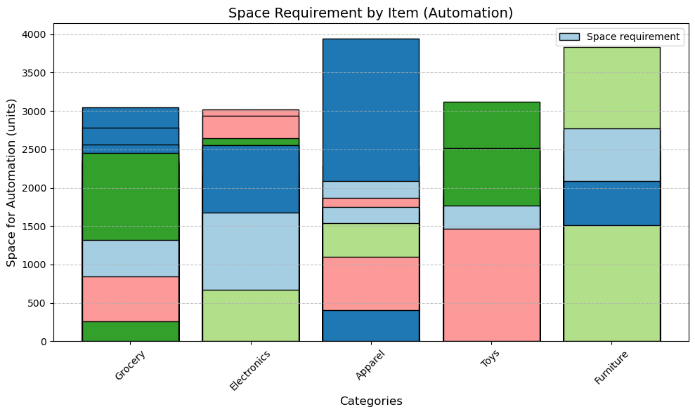
WAREHOUSE INVENTORY AUTOMATION (AMAZON ROBOTICS)
Data Science and Artificial Intelligence
Parth Patel, Vivek Prajapati
U.G. Students, Department School of Emerging Science & Technology
INTRODUCTION
MODELS
RESULTS
Warehouse inventory automation transforming the way goods are managed, stored, and shipped in large-scale operations like Amazon. By integrating advanced robotics and technology, this system automates tasks such as sorting, picking, packing, and transporting items.
Amazon Robotics uses smart robots and software to improve efficiency, accuracy, and speed in warehouses. This not only helps in meeting the growing demand for faster deliveries but also reduces operational costs and ensures a safer work environment for employees.
Through automation, companies like Amazon are setting new standards in modern warehouse management.
1. Warehouse inventory automation faces key challenges in setup cost, maintenance, and space requirements. A flexible Economic Order Quantity (EOQ) adjustment ensures efficient stock levels by varying cost factors based on product demand—lower for fast-selling items and higher for slow-moving stock.
2. To counter maintenance-related disruptions, EOQ calculations pre-stock inventory, while staggered maintenance schedules and backup automation systems enhance continuity.
3. Additionally, optimizing warehouse space for robotics is achieved by reducing EOQ by 9-10% in critical categories, enabling better movement and storage efficiency. This data-driven approach enhances overall warehouse operations, balancing cost, space, and automation reliability.
The implementation of flexible EOQ adjustments in warehouse inventory automation has led to improved efficiency in three key areas:
Cost Optimization – By dynamically adjusting EOQ based on product demand, the model prevents understocking and overstocking, reducing unnecessary storage and restocking expenses.
Operational Continuity – Pre-stocking inventory before scheduled maintenance and utilizing staggered maintenance plans have minimized disruptions, ensuring a steady order processing flow.
Space Utilization – Strategic EOQ reductions (9-10%) in selected product categories have optimized warehouse layouts, allowing robotic systems to function efficiently without compromising storage capacity.
METHODOLOGY
CONCLUSIONS
This study involves key warehouse operations such as keeping track of inventory, picking orders, and moving materials efficiently within the facility. The primary objective is to enhance overall efficiency and accuracy while minimizing the reliance on manual labor.
The approach includes a range of automation solutions, from basic systems like conveyor belts to advanced technologies such as robotics and AI-powered software. To optimize warehouse performance, this study integrates Economic Order Quantity (EOQ) and Reorder Point (ROP) models while considering real-world constraints, including automation setup, maintenance requirements, and space limitations.
Warehouse automation significantly enhances speed, accuracy, and cost efficiency, making operations more streamlined and productive. While challenges such as high initial costs, ongoing maintenance, and space constraints exist, they can be effectively managed through strategic planning and optimization. As technology continues to evolve, automation systems will become even more advanced, improving efficiency, reliability, and adaptability to various warehouse environments. Businesses that invest in smart automation solutions will gain a competitive edge, reducing operational costs and meeting growing market demands with greater precision.
REFERENCES
1. Wurman, P. R., D Andrea, R., & Mountz, M. (2008). Coordinating Hundreds of Cooperative, Autonomous Vehicles in Warehouses. AI Magazine.
2. Gu, J., M., & McGinnis, L. F. (2010). Research on warehouse design and performance evaluation: A comprehensive review. European Journal of Operational Research, 203(3), 539–549.
CONTACT
DS & AIML (Sem – 6)
Parth Patel & Vivek Prajapati
Gujarat University
Email: parthppa7931@gmail.
com
Chart 1. Automation Setup cost
Chart 2. Automation Maintenance
Chart 3. Automation Space-requirement

